Slide 1

Census Project Name: Boboye Adejuwon Student Id: 202346817

Slide 2

AGENDA
Outline
Aim & Objective
Data Exploration
Data Cleaning Process
Visualizations
Key Findings & Future Analysis.

Slide 3

Aim & Objective
Preprocess and clean the census data using programming techniques.
Perform hypothesis testing and statistical analysis to gain relevant insight.
Data-led decision-making of land development and investment drawn from a thorough analysis of census data.

Slide 4
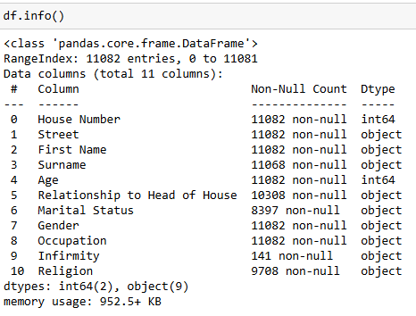
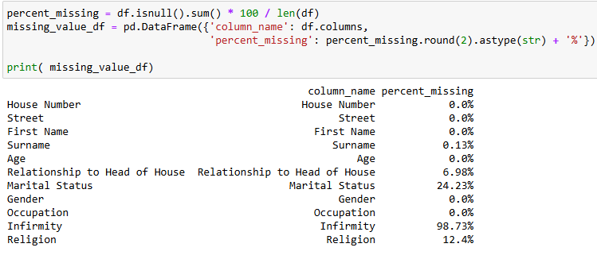
Data Exploration
Dataset has 11 columns and 11082 rows
‘House Number’ and ‘Age’ are Integer data types
Infirmity has the highest percentage of missing values with 98.73%, Marital Status 24.23%, Religion 12.4%, Relationship to Head of House 6.98% and Surname 0.14%.

Slide 5
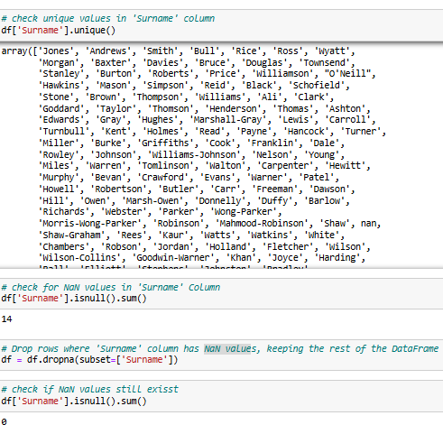
Data Cleaning
Cleaning ‘Surname’ Column
Dropped the ‘NaN’ values since they were less than 0%

Slide 6
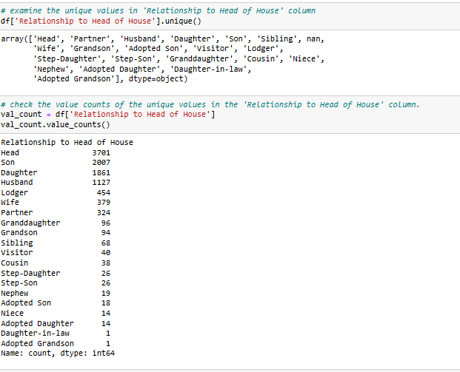
‘Relationship to Head of House’
Unique count of values in ‘’Relationship to Head of House’ Column

Slide 7

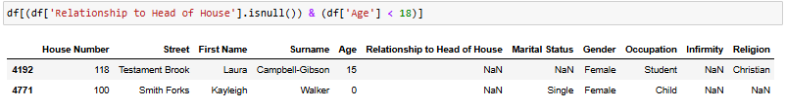
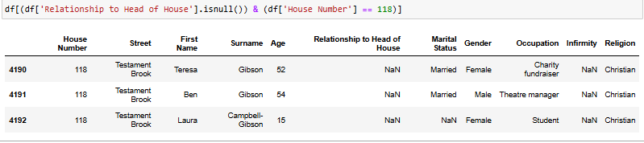
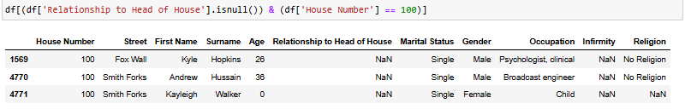
Cleaning ‘Relationship to Head of House’ Column
Examined the sum of Null values in ‘Relationship to Head of House’ column
Relationship to Head of House where Age < than 18 returned two values
I checked the House Number to find their family and her compound name suggests she is most likely a Step Daughter for the 15-year-old.
And the Child Aged 0 is most likely adopted

Slide 8
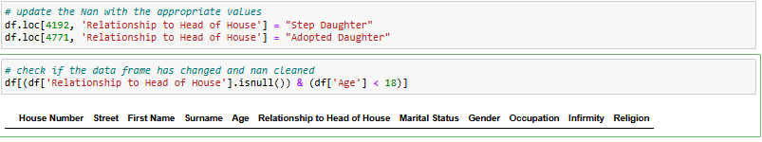
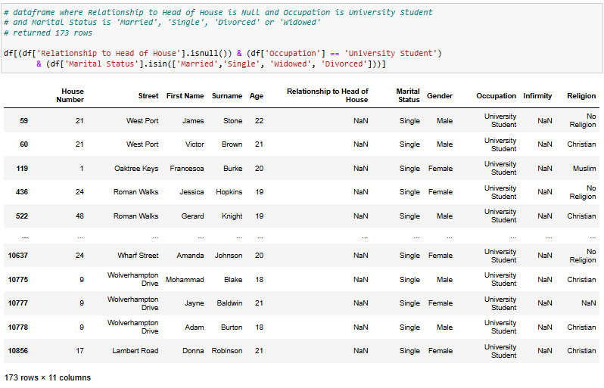
I updated the dataset with the appropriate values according to my analysis
Also examined the relationship with other columns such as Occupation, and Marital Status.
Returned 173 rows out of 774.
About 22.5% of the Null values.

Slide 9
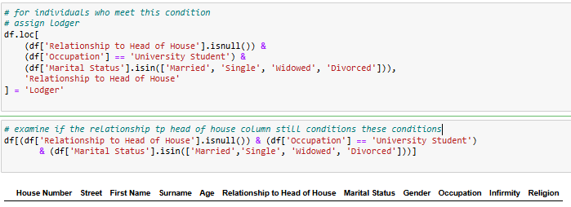
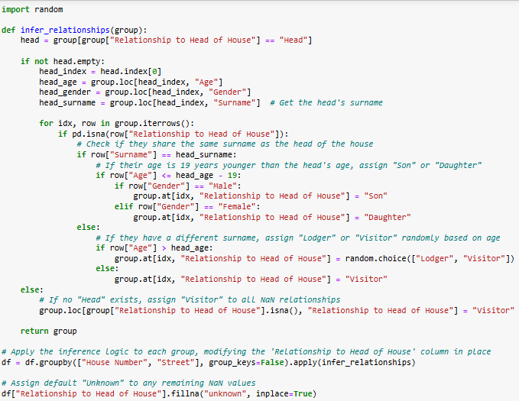

For those who met the condition, I assumed they were University Students who rented apartments and assigned ‘Lodger’ under ‘Relationship to Head of House’ column.
Finally, I wrote a custom function that extracted the head of the house
and the surname, age and gender. The function iterates over the nan rows and
Assigns daughter, son, visitor, or lodger based on specified conditions.
For those who do not meet the conditions, I replaced them with unknown.
Finally, I checked if the ‘Relationship to the Head of House’ column still
contained ‘nan’ values and replaced with unknown’

Slide 10
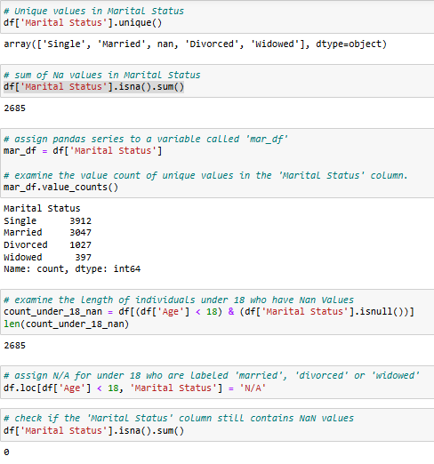
Cleaning and Analysing ‘Marital Status’ Column
Examined the unique values and the number of missing values
in ‘Marital Status’.
Also checked the value count of each unique value.
Further Analysis revealed many underaged lied about their marital status
Assigned N/A for those under 18 labeled 'married', 'divorced’,
or 'widowed’.
Analysis revealed that the total number of NaN values in the
‘Marital Status’ column was the same as those who were under 18.
2685 NaN values which is 24.23% of the total missing values in the
Census data.

Slide 11
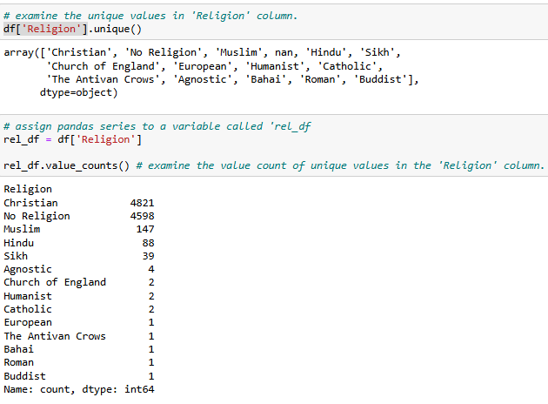
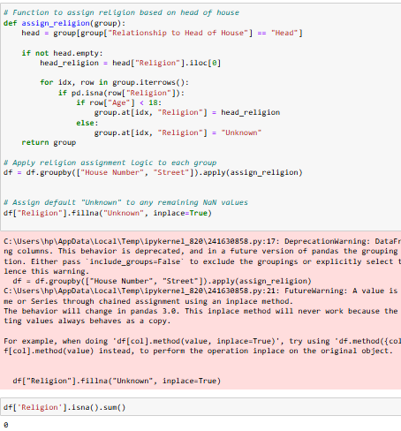
Cleaning and Analysing ‘Religion’ Column
Examined the unique values and their count
Defined a Function that assigned the Religion of the ‘Head of the house if the age is less than 18 for those living in the same house. And ‘unknown’ for those who don’t meet the condition.

Slide 12
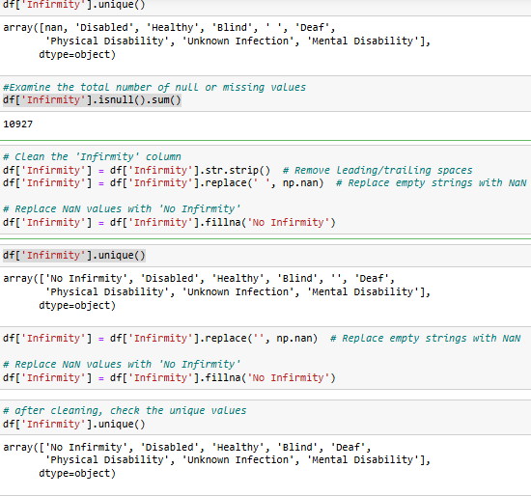
Cleaning ‘Infirmity’ Column
Examined unique values in ‘Infirmity’ column
Cleaned the empty strings with trailing spaces and replaced them with NaN values
I went further and replaced the NaN Values with ‘No Infirmity’.

Slide 13
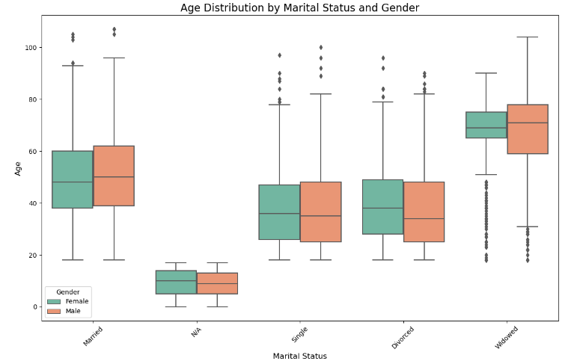
Visualizations and Early Insights
Median Age of Single males is 31
Median Age of Single females is 30
A Significant Number of those with N/A – ‘Not Applicable’ are under 18 years old.
Median Widowed Age is around 70 for male and female which shows a relatively healthy population.
There are a significant number of early divorcees.

Slide 14
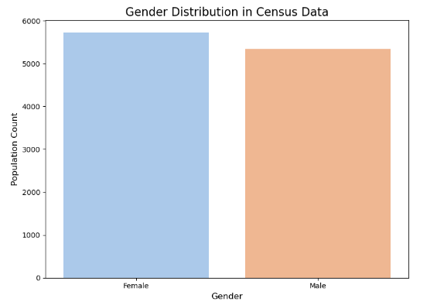
Gender
There is a significant number of females in the census data.
Increase accessibility to pregnancy-related services, including prenatal clinics and childbirth facilities.
Provide family planning, contraception, and gynecological care.
Conduct campaigns on maternal health, nutrition, and child care.
Female
Gender
Male

Slide 15
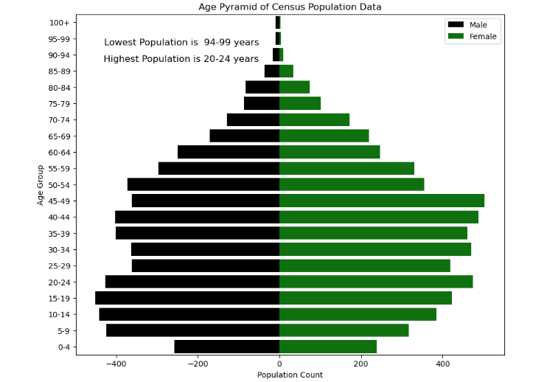
Age Pyramid
20-24 is the Highest Age Group
45-49 is the Second Highest Age group
High-density housing should be built if there’s a significant expansion in the population between 20-54 age group.
A Railway Station should be built because it appears there’s a significant number of 15-29 age group who will most likely be commuters.
Employment and training should be prioritized If there is evidence of unemployment for 20-44.
Parks and Playground should be built for ages 4-14. Also, there might be a need for retirement homes for 45-59 in the next two decades which should be considered in future town planning initiatives.
Medical centers should be built to cater for future pregnant women ages 20-34 or to the general population which seems to be growing.
An increase in spending for school-aged children 5-15 should be considered since there is evidence of a growing population within that Age Group.
Infrastructural development should be invested in, particularly services such as waste management, road maintenance, and security will require additional funding to meet growing demands (i.e families moving to town). These improvements will benefit residents of all groups.

Slide 16
Further Analysis.
Birth Rate
Employment Status
Commuters
Death Rate
Religious Distribution

Slide 17

THANK YOU
Boboye Adejuwon

